Slide 1
The XMLHttpRequest Object
AJAX is not a programming language.

Slide 2
AJAX stands for Asynchronous JavaScript And XML
AJAX is a technique for accessing web servers from a web page.

Slide 3
The HTML page contains a <div> section and a <button>.
The <div> section is used to display information from a server.
The <button> calls a function (if it is clicked).
The function requests data from a web server and displays it:
JavaScript and HTML DOM (to display or use the data)

Slide 4
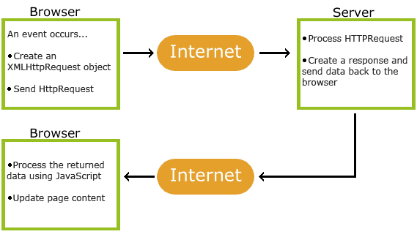
. An event occurs in a web page (the page is loaded, a button is clicked)
2. An XMLHttpRequest object is created by JavaScript
3. The XMLHttpRequest object sends a request to a web server
4. The server processes the request
5. The server sends a response back to the web page
6. The response is read by JavaScript
7. Proper action (like page update) is performed by JavaScript

Slide 5
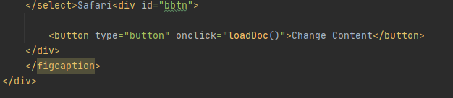

Slide 6
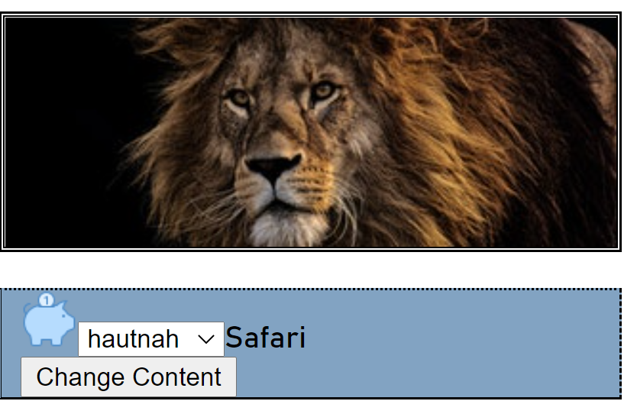
An XMLHttpRequest object is created by JavaScript
The XMLHttpRequest object sends a request to a web server

Slide 7
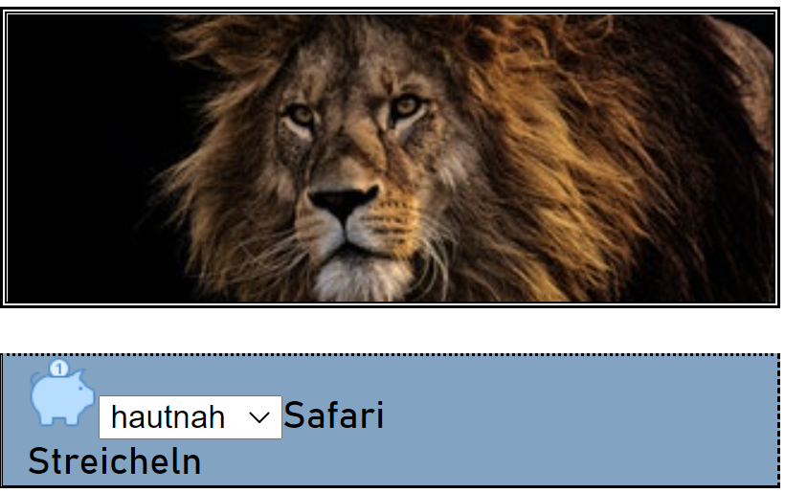
The response is read by JavaScript
Proper action (like page update) is performed by JavaScript

